Slide 1


Slide 2





MAS Digital Fabrication
Digital Architecture
Robotic Bricks

Slide 3
using discrete elements to build complex assemblies

Slide 4
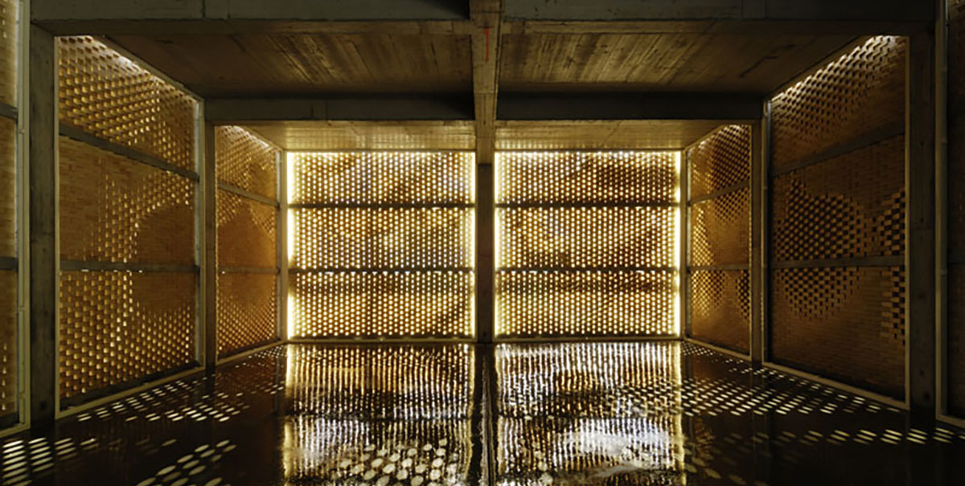

Slide 5
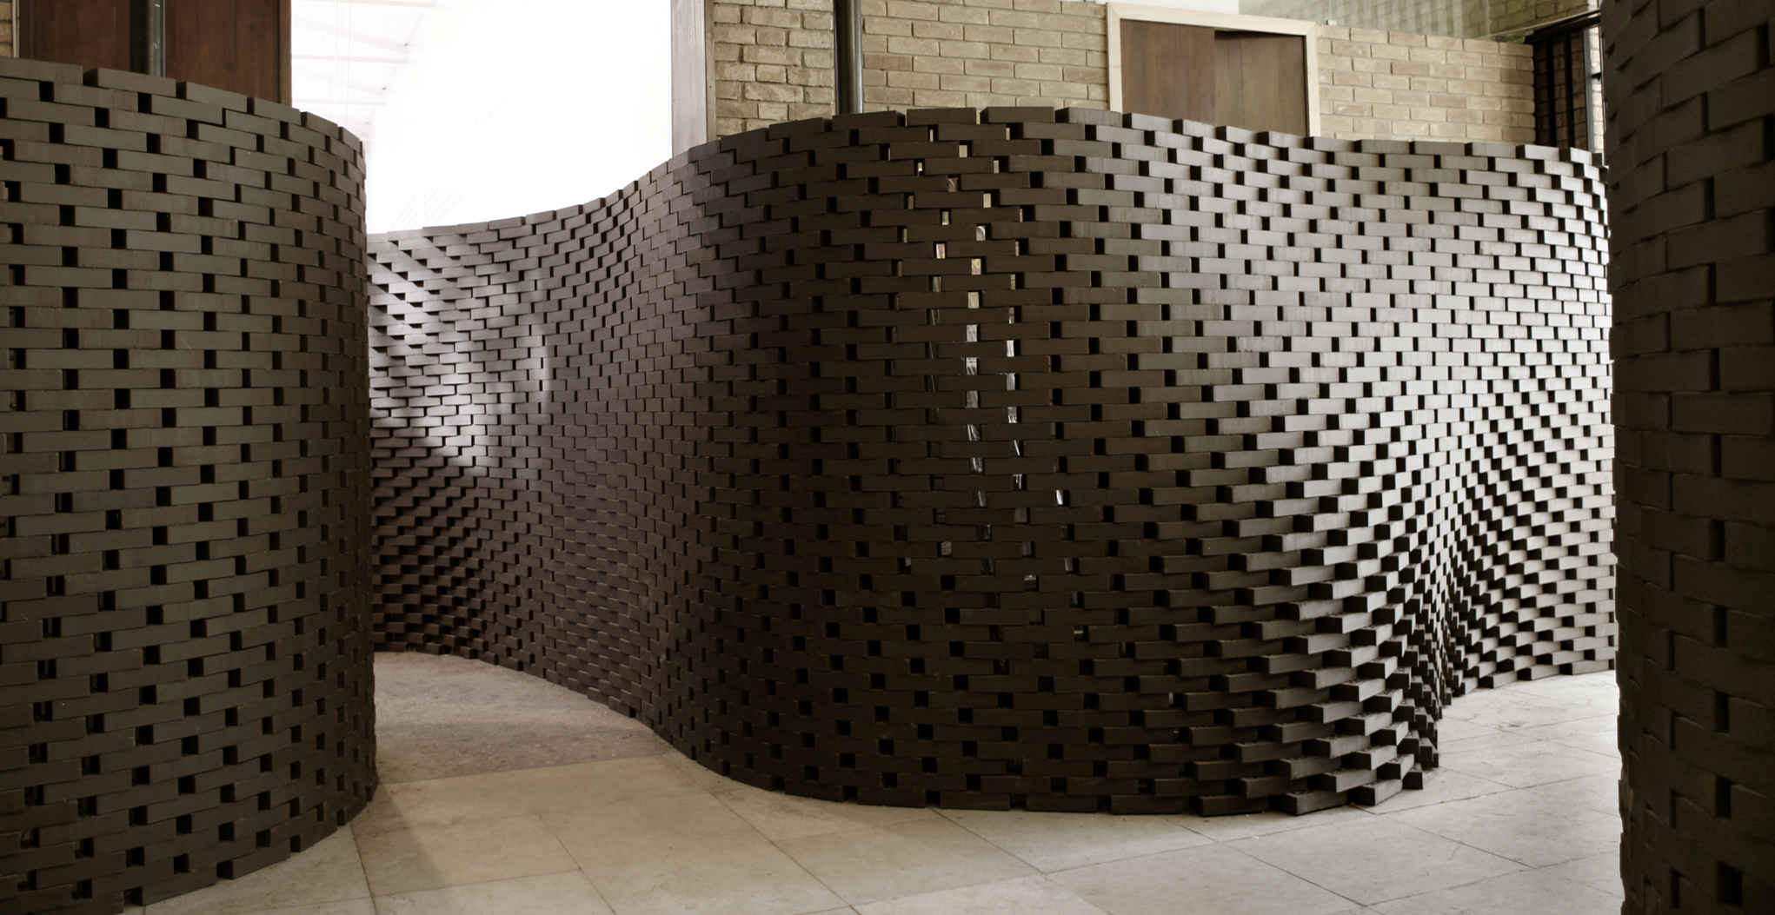

Slide 6
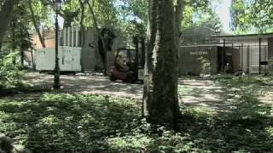

Slide 7
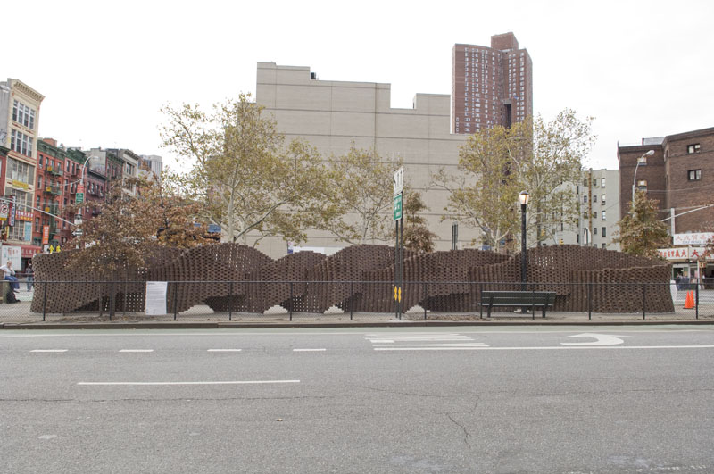
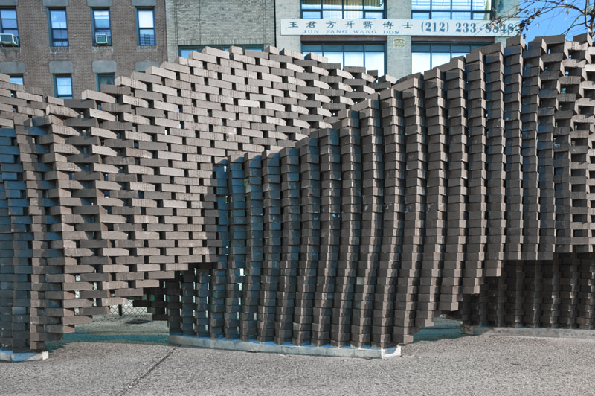

Slide 8
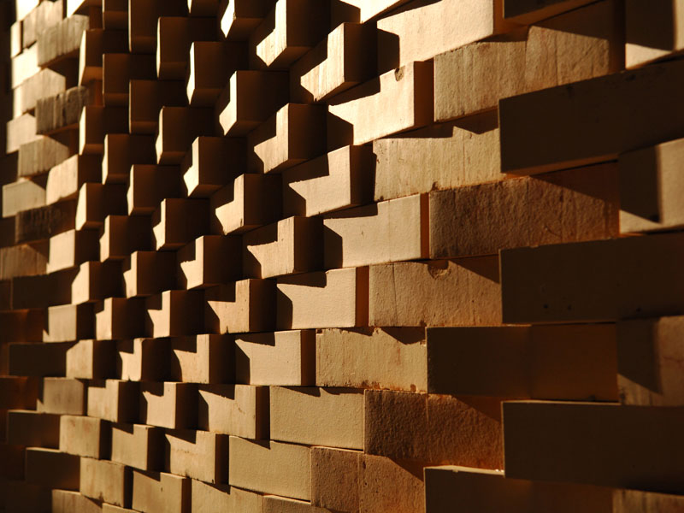
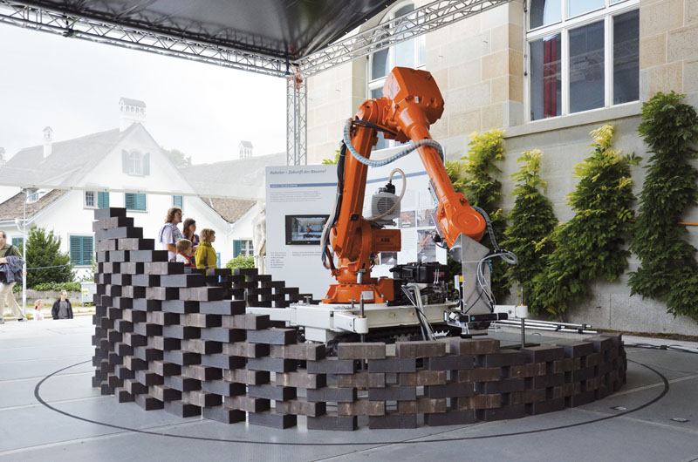

Slide 9
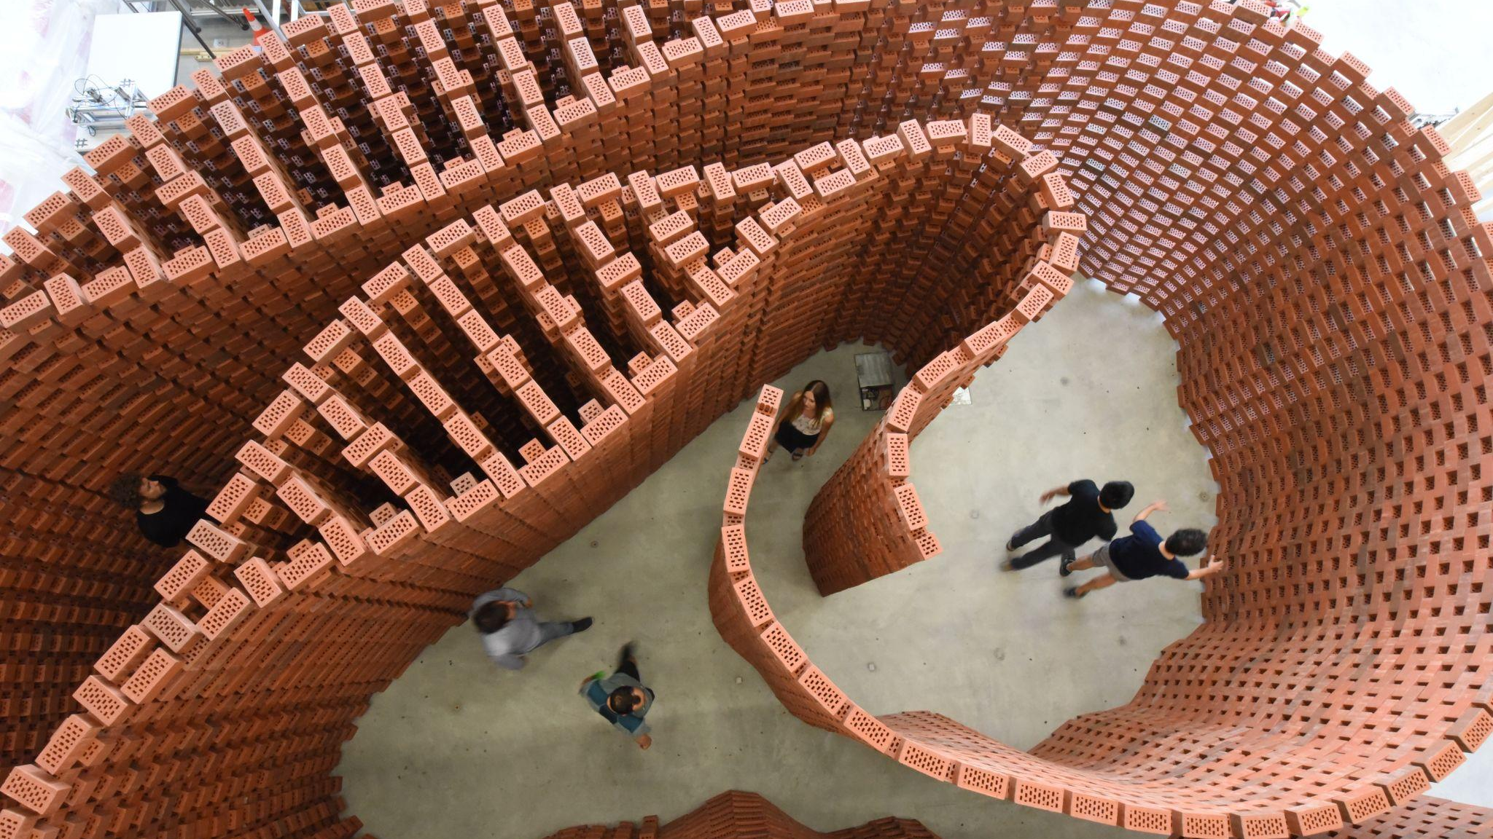

Slide 10
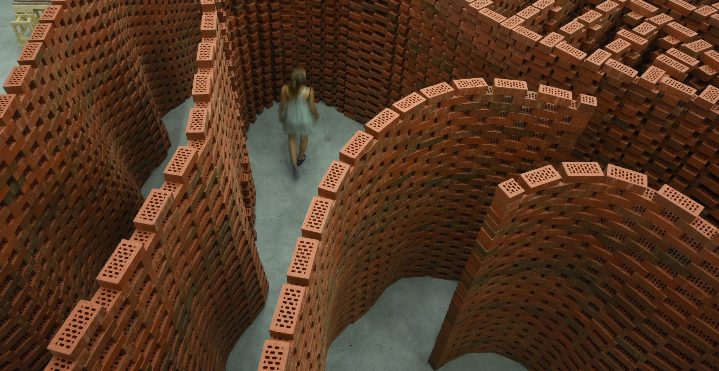

Slide 11
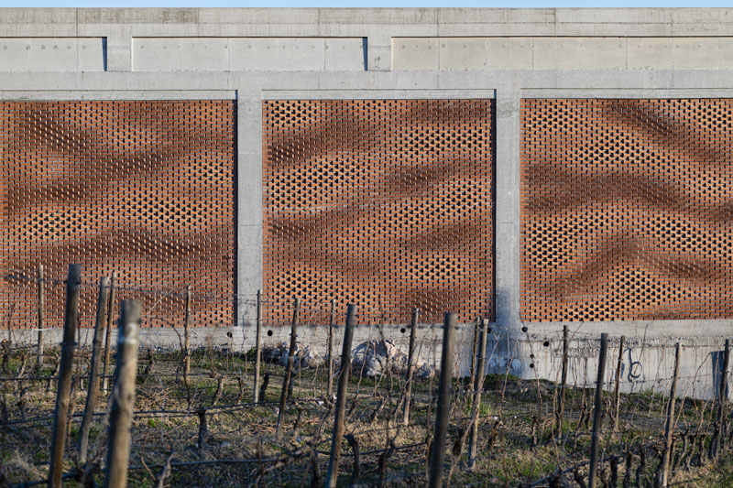

Slide 12
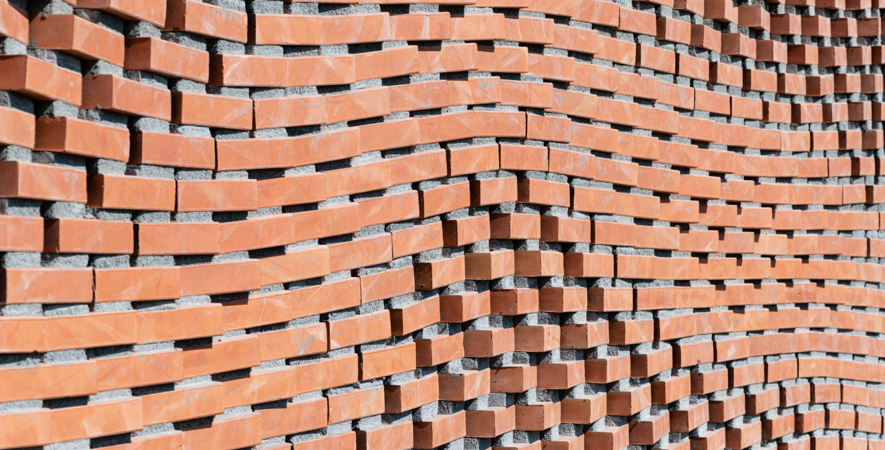

Slide 13
how to design discrete assemblies for robotic fabrication?

Slide 14
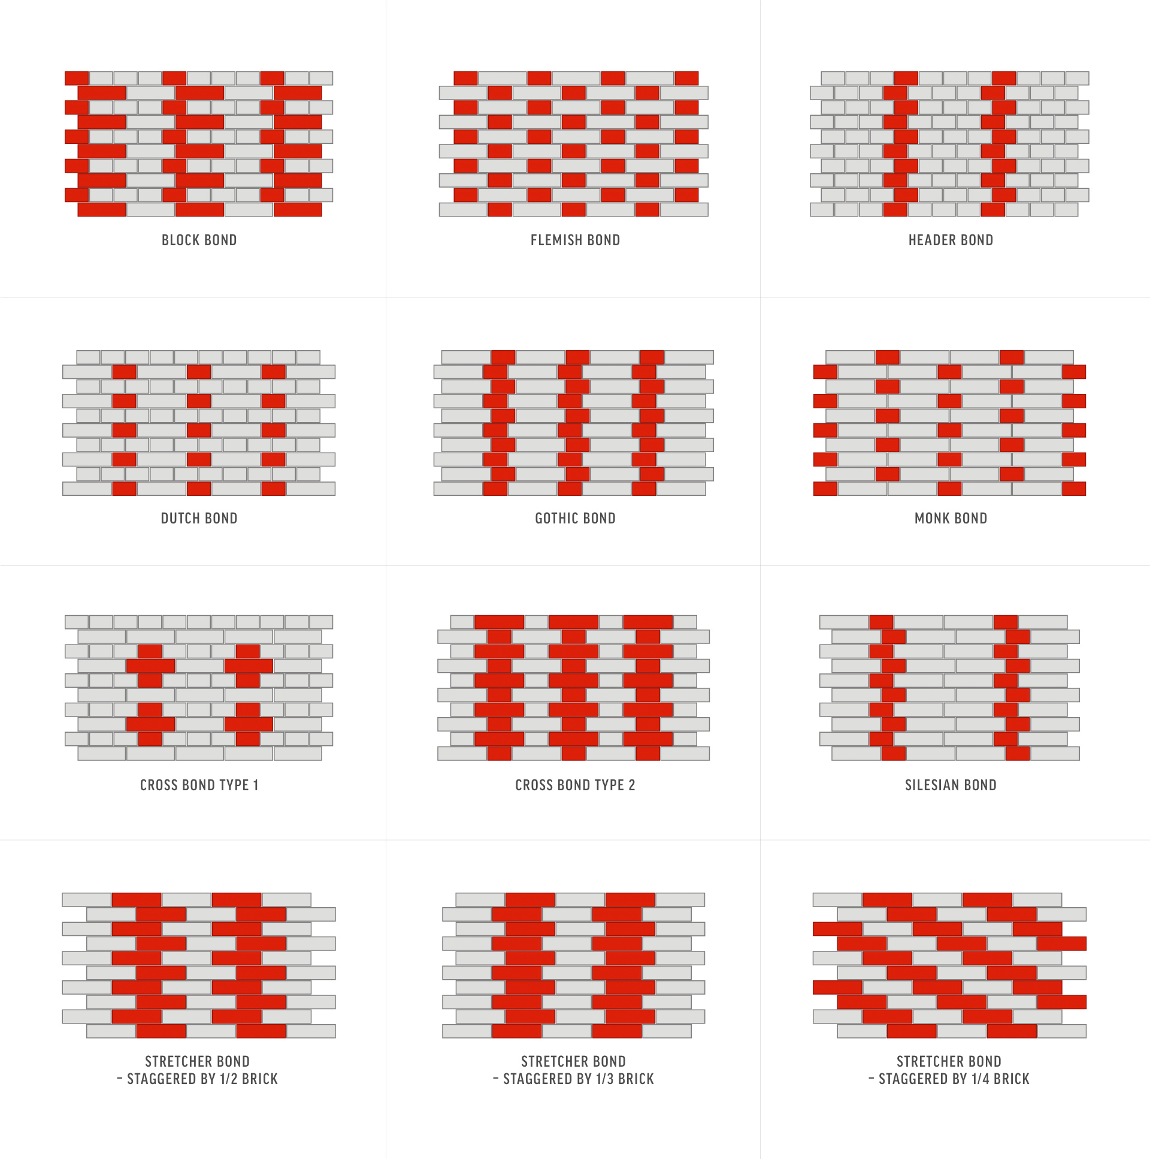
computational brick bonds

Slide 15
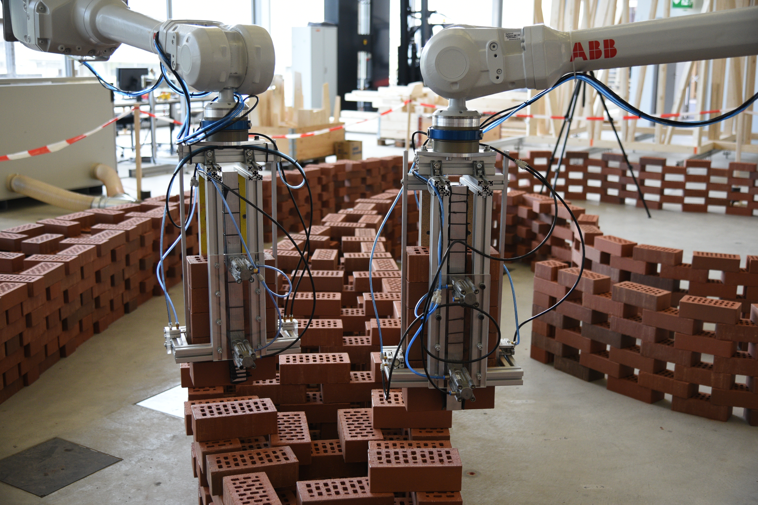
tolerance by design

Slide 16
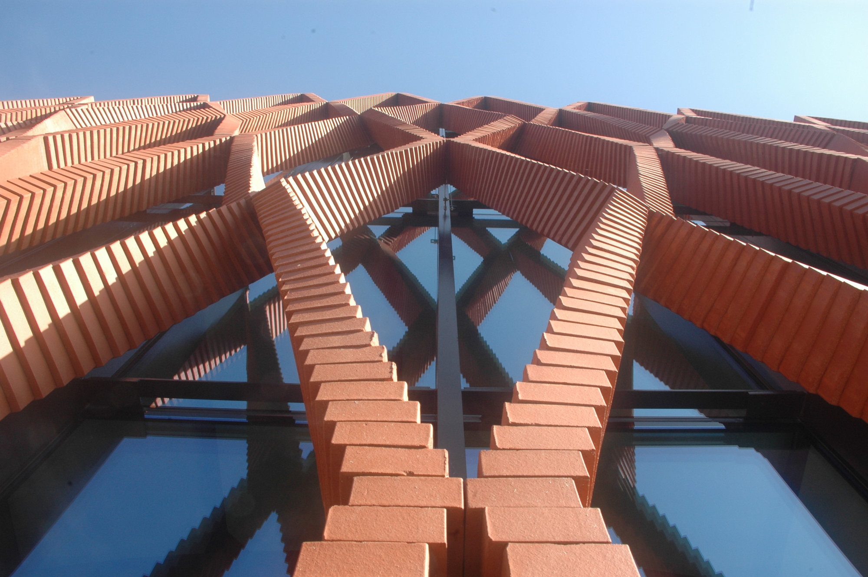
stability

Slide 17
sequencing

Slide 18
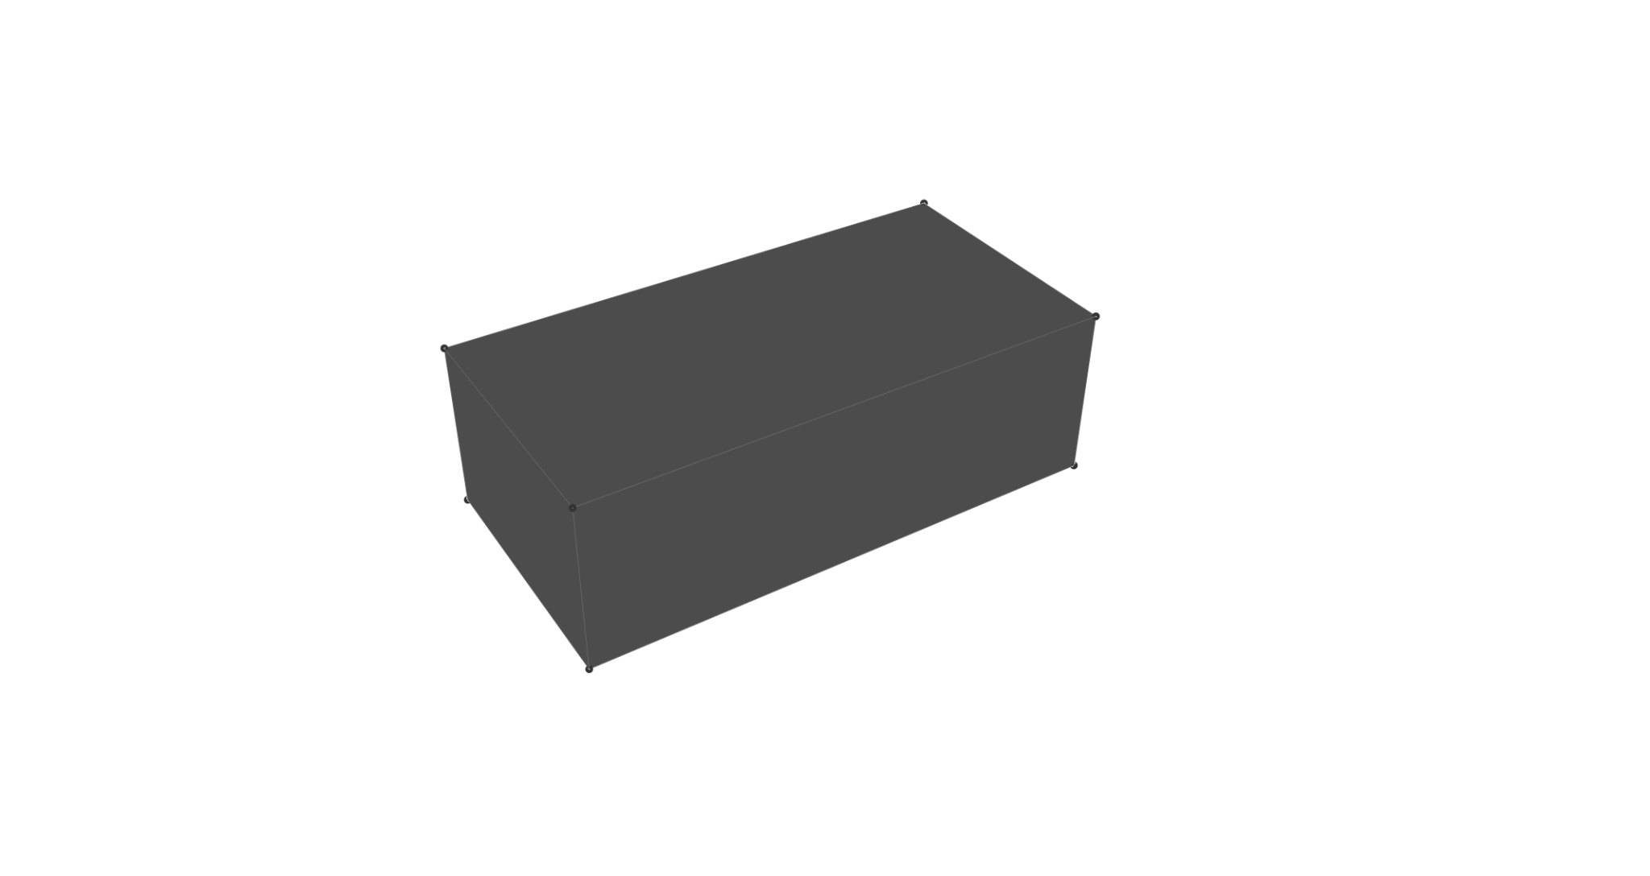
bricks as object(s)

Slide 19
bricks as object(s)
h
w
l

Slide 20
bricks as object(s)
Point(-l/2, -w/2, -h/2),
Point(-l/2, w/2, -h/2),
Point(l/2, w/2, -h/2),
Point(l/2, -w/2, -h/2),
Point(-l/2, -w/2, h/2),
Point(l/2, -w/2, h/2),
Point(l/2, w/2, h/2),
Point(-l/2, w/2, h/2)
6
5
7
2
3
1
4
0

Slide 21
assignment: mini robotic bricks

Slide 22
computational design logic for brick wall incorporating some of the themes mentioned above
use object-oriented concepts (classes) to define your bricks and brick walls
series of experiments(dry stacked) and one final brick wall(glued) demonstrating design logic

Slide 23


COMPAS (inside) Rhino/GH
Universal robots UR5/UR10 with vacuum gripper setup
provided mini bricks

Slide 24
hardware setup

Slide 25
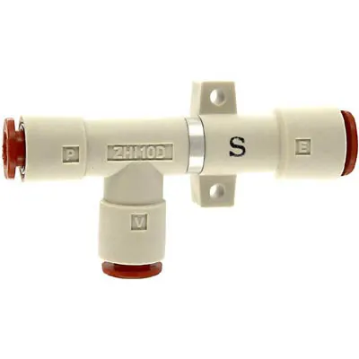
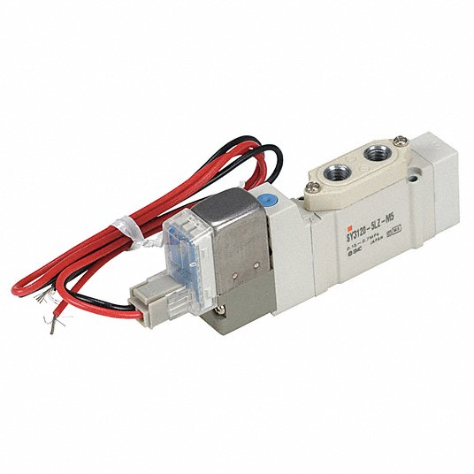
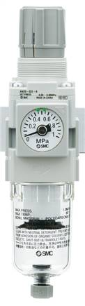
venturi vacuum ejector(mount on end effector)
exhaust
solenoid valve(mount on robot base)
vacuum suction pressure
compressed air from supply
(0.7 MPa)
regulated air(0.2-0.5 MPa)
pressure regulator(mount on robot base)

Slide 26
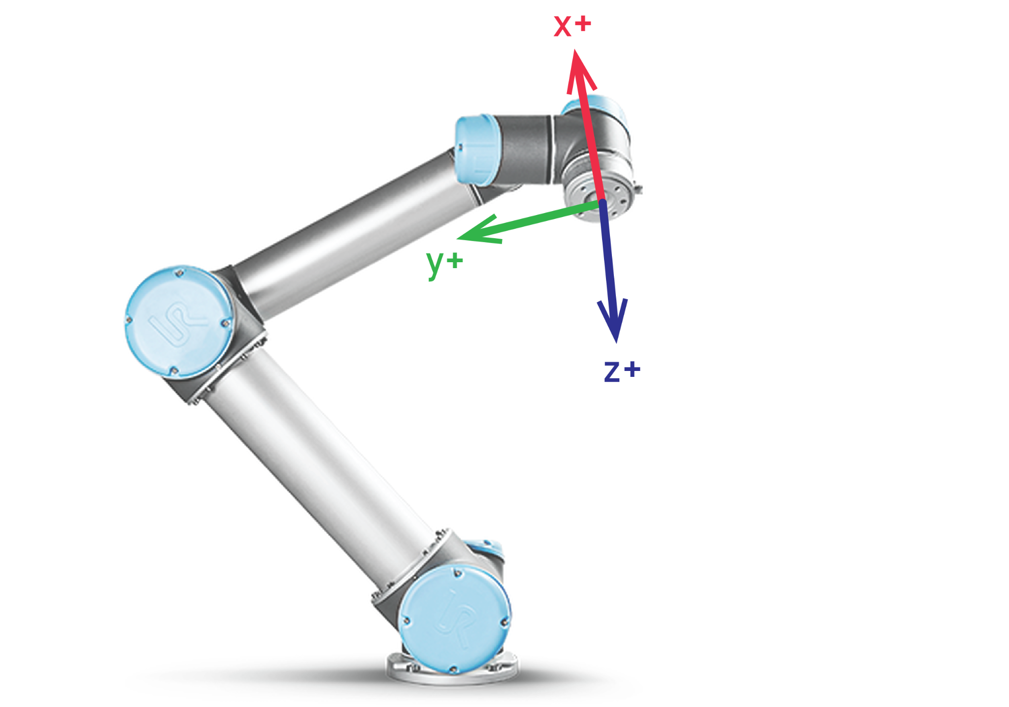

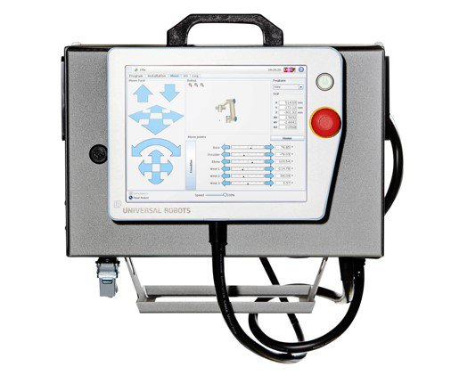
on/off for air
ur script commands
(movement/signal)

Slide 27
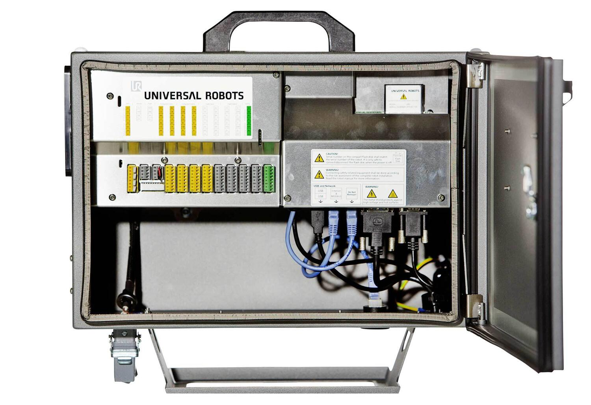
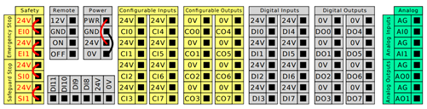

Slide 28
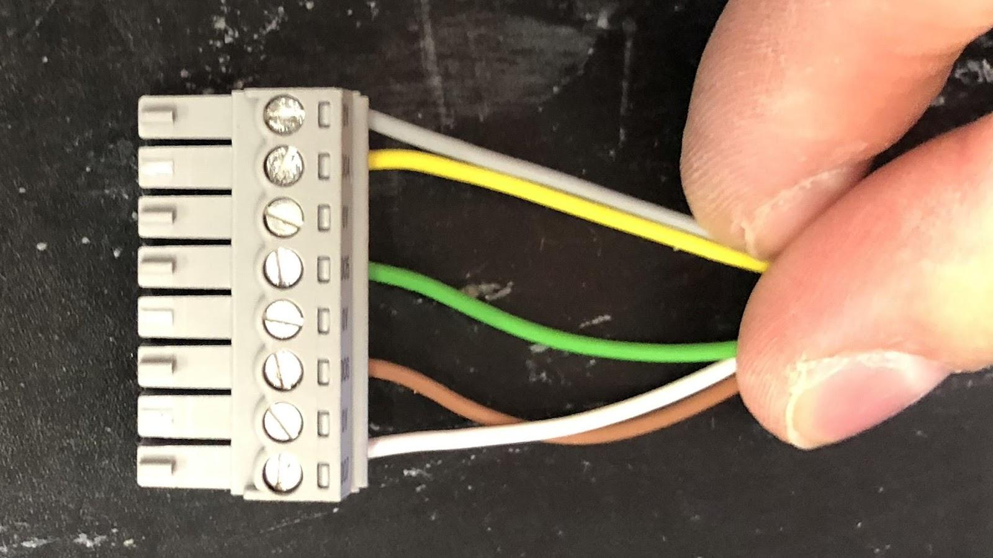
Digital IO Signals are +24V or 0V
0v
black
DO0
red
0v
DO1
0v
DO2

Slide 29
do’s and don'ts

Slide 30
do turn off the main air supply after use
do double check wiring connections before testing
do use only as much tubing as you need
do guide tubes neatly along the robot arm
do guide all tube from supply to robot neatly along the wall/floor

Slide 31
don’t use random tools to do what they are not supposed to do
don’t stretch tubes/cables around the workspace/ robot arm
don’t hesitate to ask if you don’t know how to do something :)

